Slide 1
Introduction to Bayesian Statistics
Fundamentals for applied research
Doug Leasure Senior Researcher and Data Scientist Demographic Science Unit Dept. Population Health University of Oxford

Slide 2
Learning outcomes
Understand the components of Bayes theorem: Priors, likelihood, posteriors
Familiarity with probability distributions and how to select among them
Experience coding Bayesian models and fitting them with MCMC using Stan software from R
Exposure to a few different types of models Linear regression, generalised linear models, hierarchical models
Practice with basic model diagnostics and cross-validation
Ability to develop and implement your own Bayesian models: Data model + process model + parameter model

Slide 3

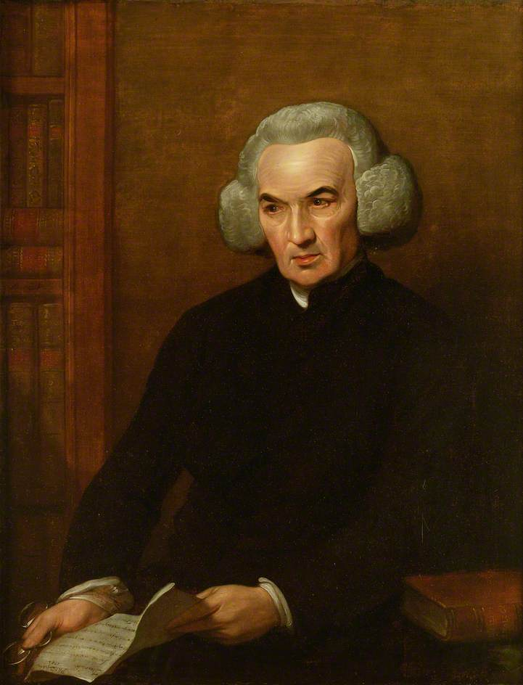
Reverend Thomas Bayes c.1701-1761
Dr. Richard Price 1723-1791
Bayes T. 1763. An essay towards solving a problem in the doctrine of chances. Philosophical Transactions of the Royal Society of London. 53:370-418.

Slide 4
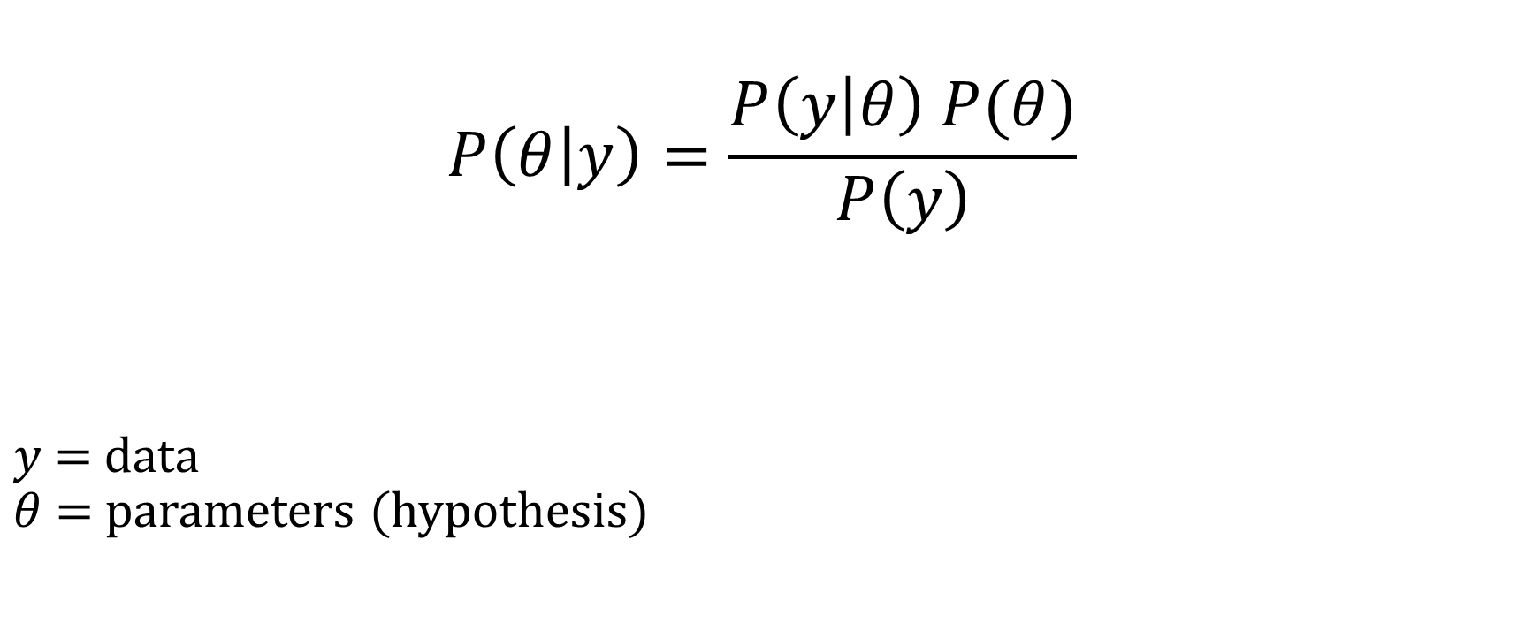
Bayes’ theorem
$$P\left(θ | y\right)=\frac{P\left(y | θ\right) P(θ)}{P\left(y\right)}$$
$y$ = data $θ$ = parameters (hypothesis)
Likelihood
Prior(s)
Posterior
Scaling Factor

Slide 5
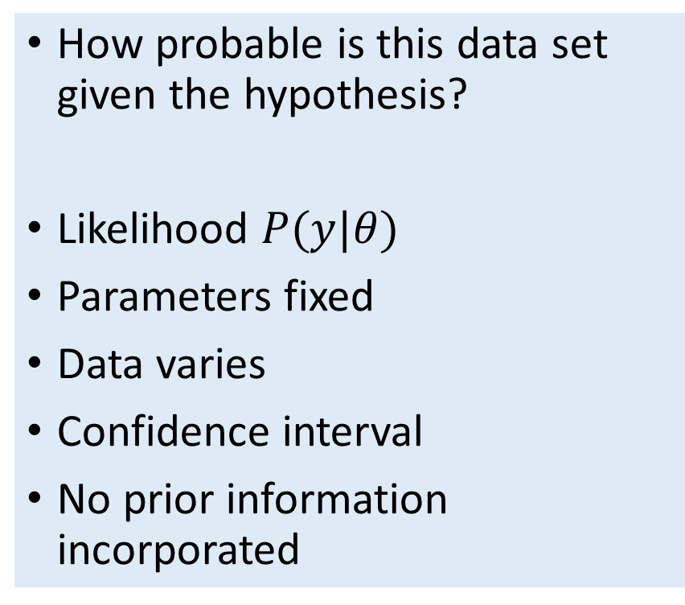
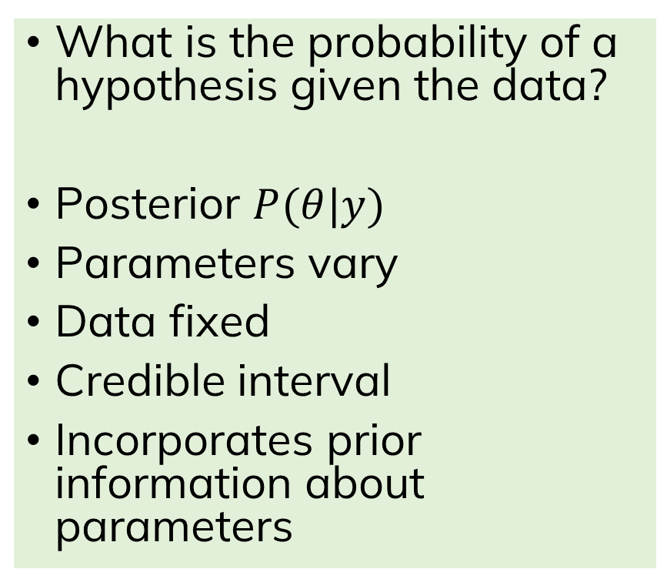
Bayesian vs frequentist modes of inference
Frequentist
Bayesian
How probable is this data set given the hypothesis?
Likelihood $P(y|θ)$
Parameters fixed
Data varies
Confidence interval
No prior information incorporated
What is the probability of a hypothesis given the data?
Posterior $P(θ|y)$
Parameters vary
Data fixed
Credible interval
Incorporates prior information about parameters

Slide 6
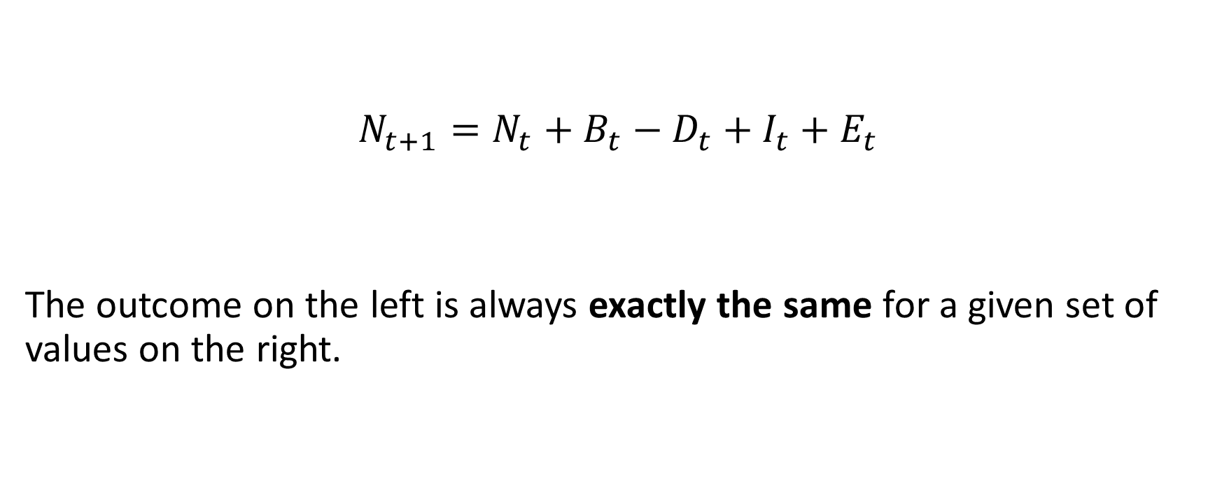
What is a “deterministic” model?
$$N_{t+1}=N_{t}+B_{t}−D_{t}+I_{t}+E_{t}$$
The outcome on the left is always exactly the same for a given set of values on the right.

Slide 7
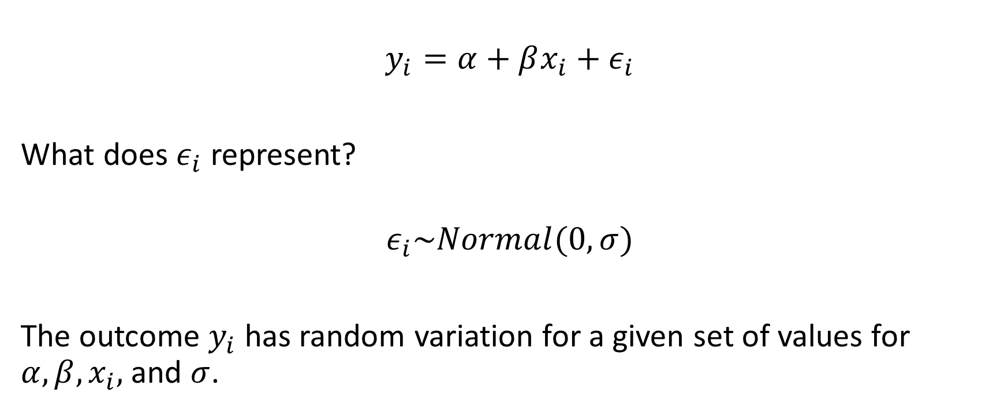
What is a “stochastic” model?
$$y_{i}=α+βx_{i}+ε_{i}$$
What does $ε_{i}$ represent?
$$ε_{i}\sim Normal(0, σ)$$
The outcome $y_{i}$ has random variation for a given set of values for $α, β, x_{i},$and $σ$.

Slide 8

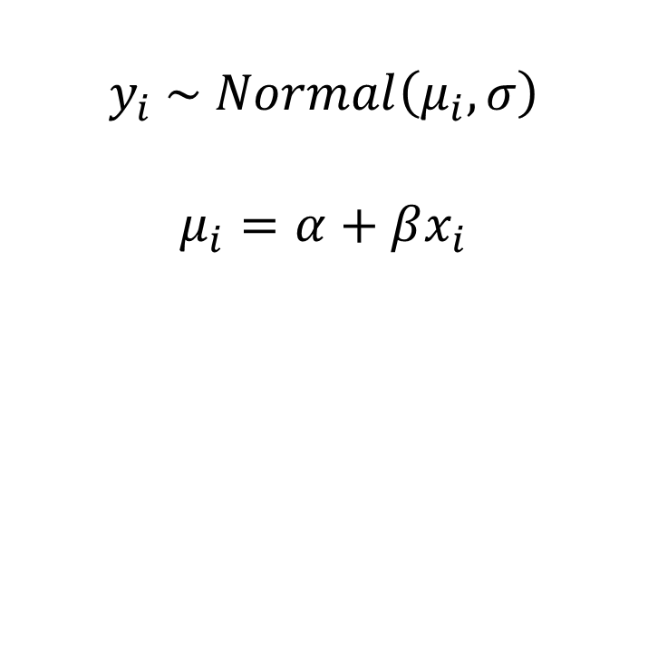
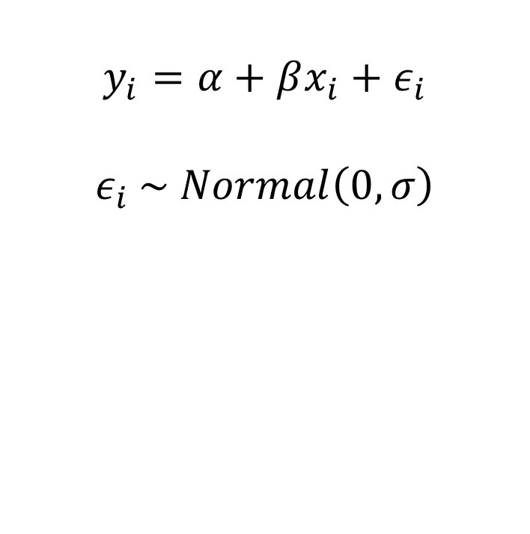
A quick (but important) word on notation…
$$y_{i}=α+βx_{i}+ε_{i}$$
$$ε_{i} \sim Normal\left(0, σ\right)$$
$$y_{i} \sim Normal\left(μ_{i},σ\right)$$
$$μ_{i}=α+βx_{i}$$

Slide 9
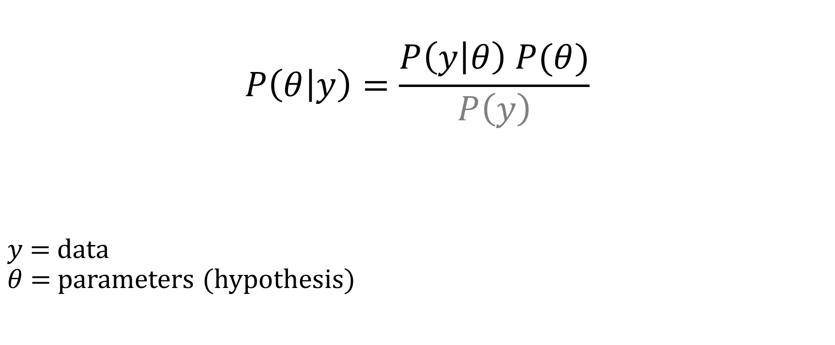
Bayes’ theorem
$$P\left(θ | y\right)=\frac{P\left(y | θ\right) P(θ)}{P\left(y\right)}$$
$y$ = data $θ$ = parameters (hypothesis)
Likelihood
Prior(s)
Posterior

Slide 10
Likelihood

Slide 11
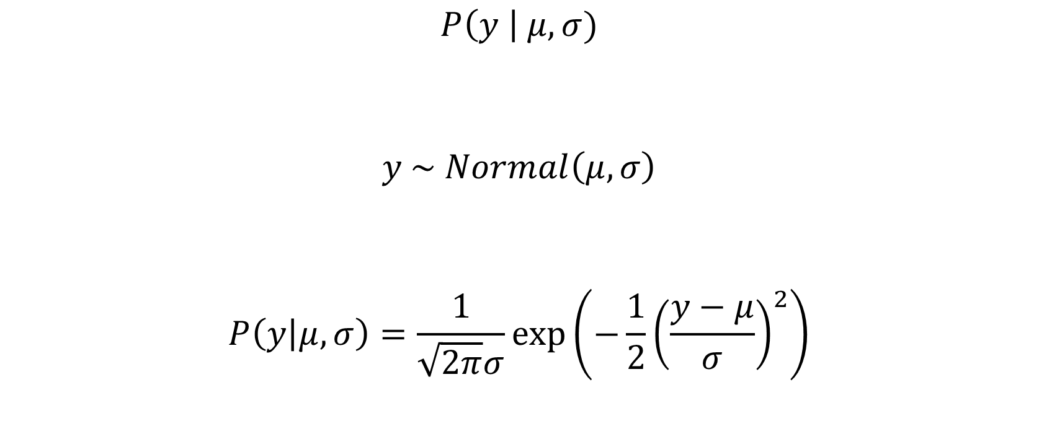
What is a likelihood, exactly?
$$P\left(y \right| μ, σ)$$
$$y \sim Normal\left(μ,σ\right)$$
$$P\left(y | μ, σ\right)=\frac{1}{\sqrt{2π}σ}\exp\left(−\frac{1}{2}{\left(\frac{y−μ}{σ}\right)}^{2}\right)$$
Probability density function (pdf) for a normal distribution

Slide 12
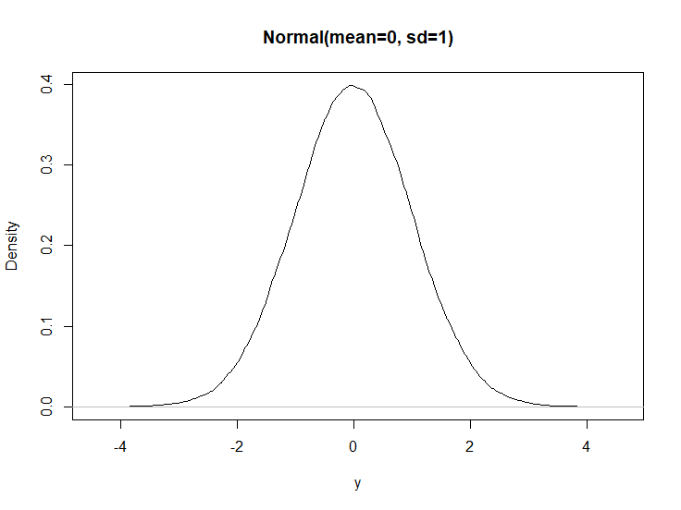
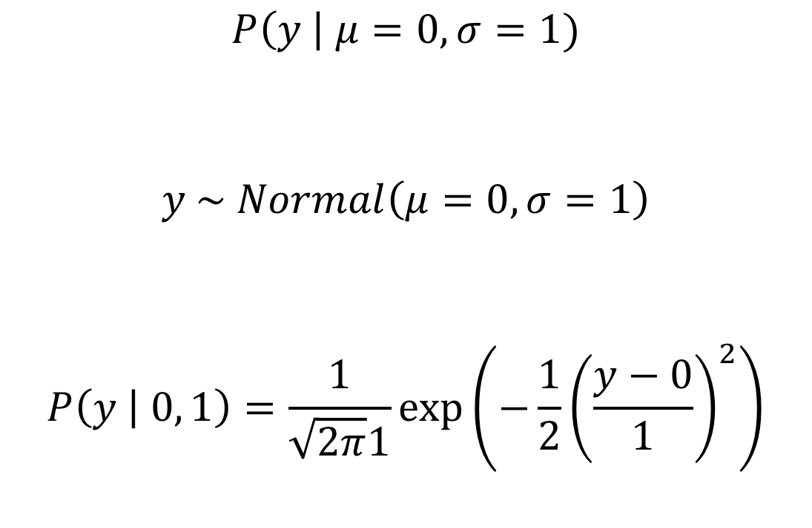
What is a likelihood, exactly?
$$P\left(y \right| μ=0, σ=1)$$
$$y \sim Normal\left(μ=0,σ=1\right)$$
$$P\left(y | 0, 1\right)=\frac{1}{\sqrt{2π}1}\exp\left(−\frac{1}{2}{\left(\frac{y−0}{1}\right)}^{2}\right)$$

Slide 13
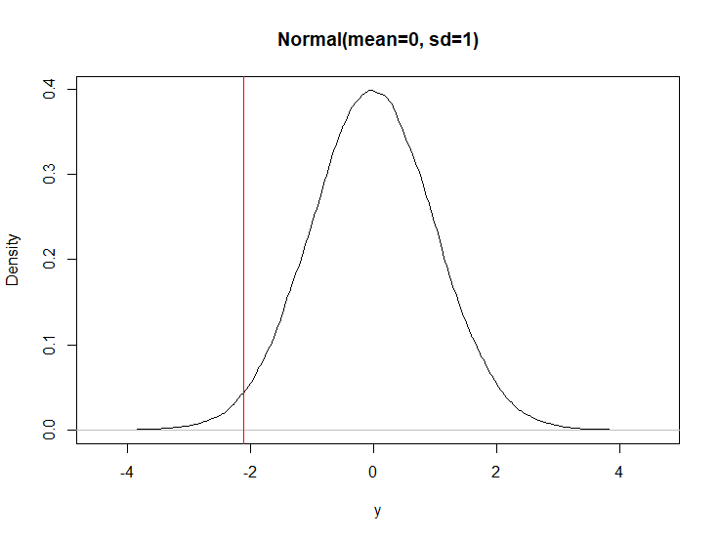
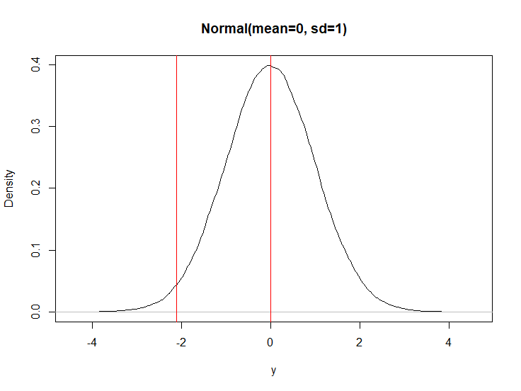
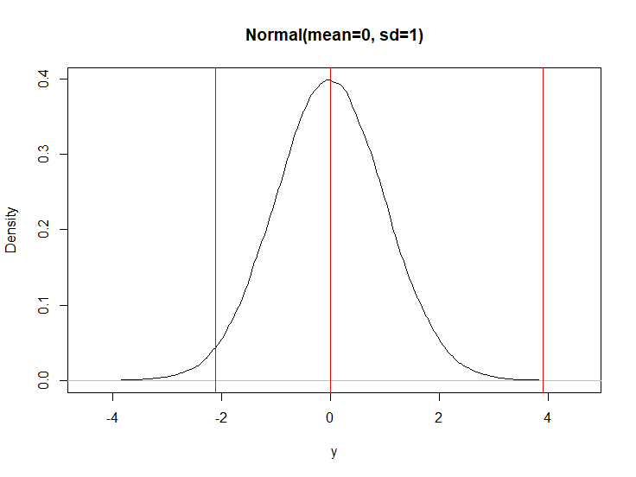
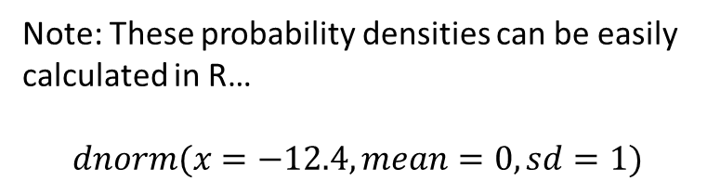
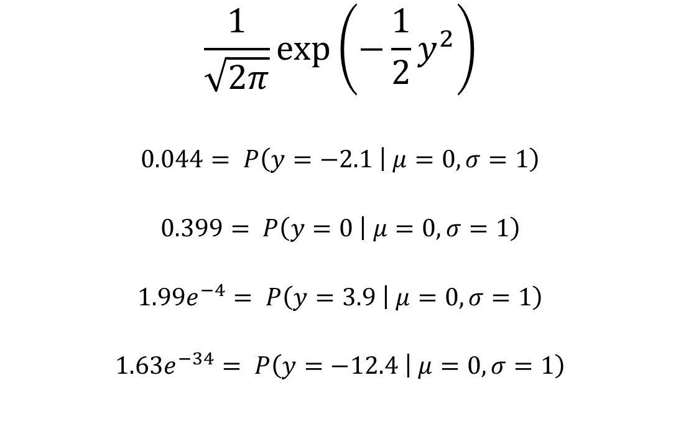
What is a likelihood, exactly?
$$\frac{1}{\sqrt{2π}}\exp\left(−\frac{1}{2}y^{2}\right)$$
$$0.044= P\left(y=−2.1 | μ=0, σ=1\right)$$
$$0.399= P\left(y=0 | μ=0, σ=1\right)$$
$$1.99e^{−4}= P\left(y=3.9 | μ=0, σ=1\right)$$
$$1.63e^{−34}= P\left(y=−12.4 | μ=0, σ=1\right)$$
Note: These probability densities can be easily calculated in R…
$$dnorm(x=−12.4, mean=0, sd=1)$$

Slide 14
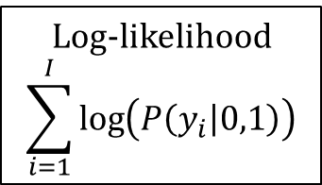
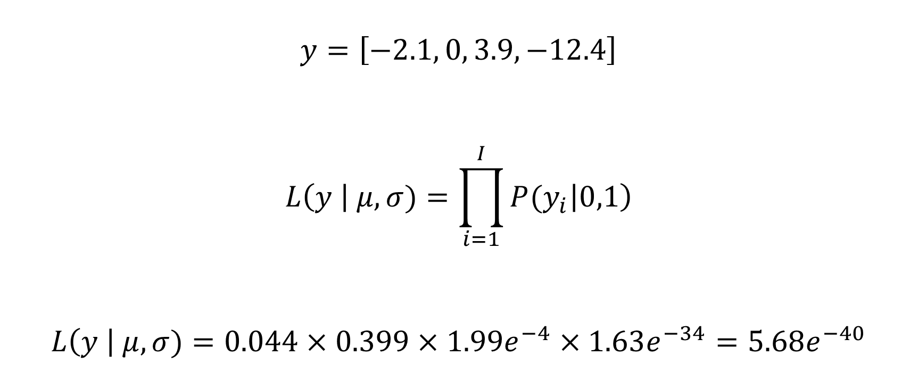
How do we calculate the likelihood for a full data set (rather than one data point)?
$$y=\left[−2.1, 0, 3.9, −12.4\right]$$
$$L\left(y \right| μ, σ)=\prod_{i=1}^{I}{{P(y}_{i}\left|0,1\right)}$$
$$L\left(y \right| μ, σ)=0.044×0.399×1.99e^{−4}×1.63e^{−34}=5.68e^{−40}$$
Log-likelihood
$$\sum_{i=1}^{I}{\log\left(P\left(y_{i} | 0,1\right)\right)}$$

Slide 15

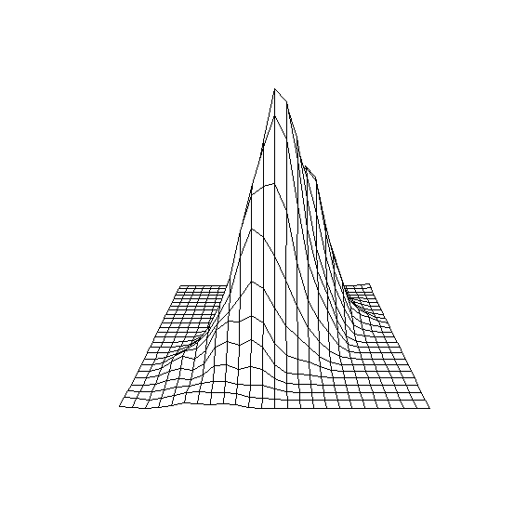

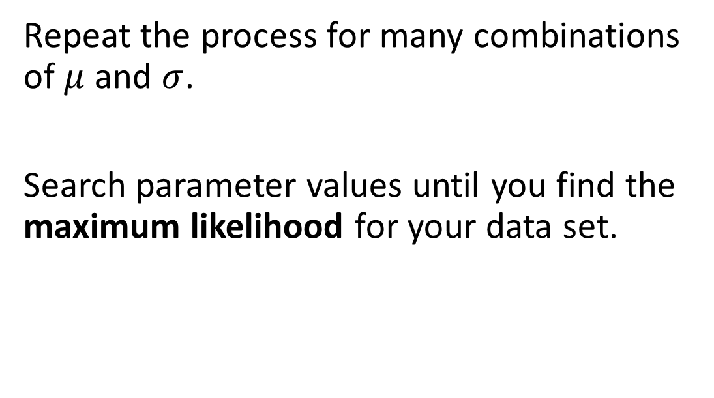



Maximum likelihood estimation
A frequentist
Repeat the process for many combinations of $μ$ and $σ$.
Search parameter values until you find the maximum likelihood for your data set.
$$P\left(y \right| μ, σ)$$
$σ$
$$μ$$

Slide 16
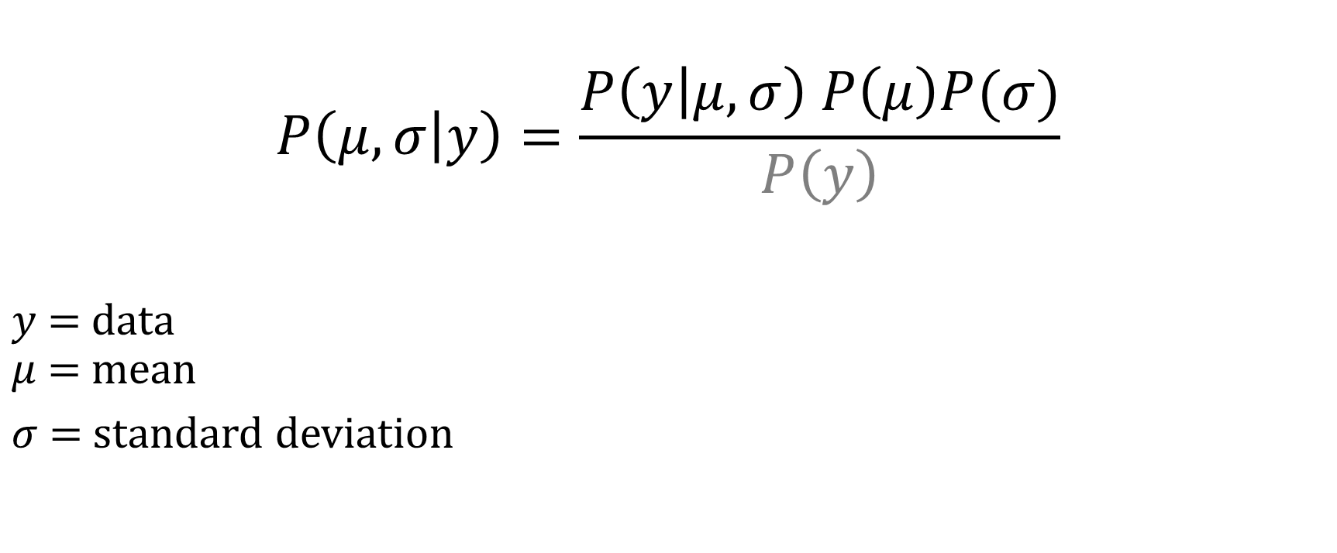
Bayes’ theorem Do we just plug in the maximum likelihood (i.e. a single number)?
$$P\left(μ,σ | y\right)=\frac{P\left(y | μ,σ\right) P\left(μ\right)P(σ)}{P\left(y\right)}$$
$y$ = data $μ$ = mean
$σ$ = standard deviation
Likelihood
Priors
Posterior

Slide 17
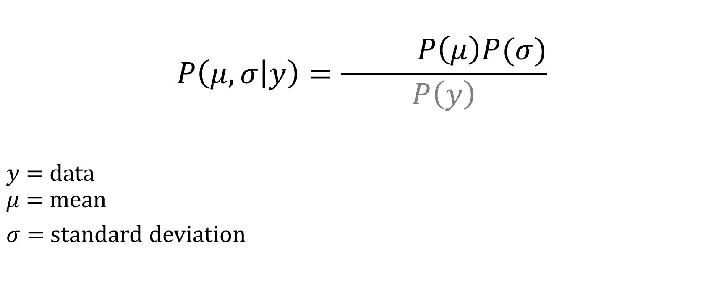
Bayes’ theorem Every term in Bayes theorem is a probability distribution.
Likelihood
$$P\left(μ,σ | y\right)=\frac{ P\left(μ\right)P(σ)}{P\left(y\right)}$$
$y$ = data $μ$ = mean
$σ$ = standard deviation
Priors
Posterior

Slide 18
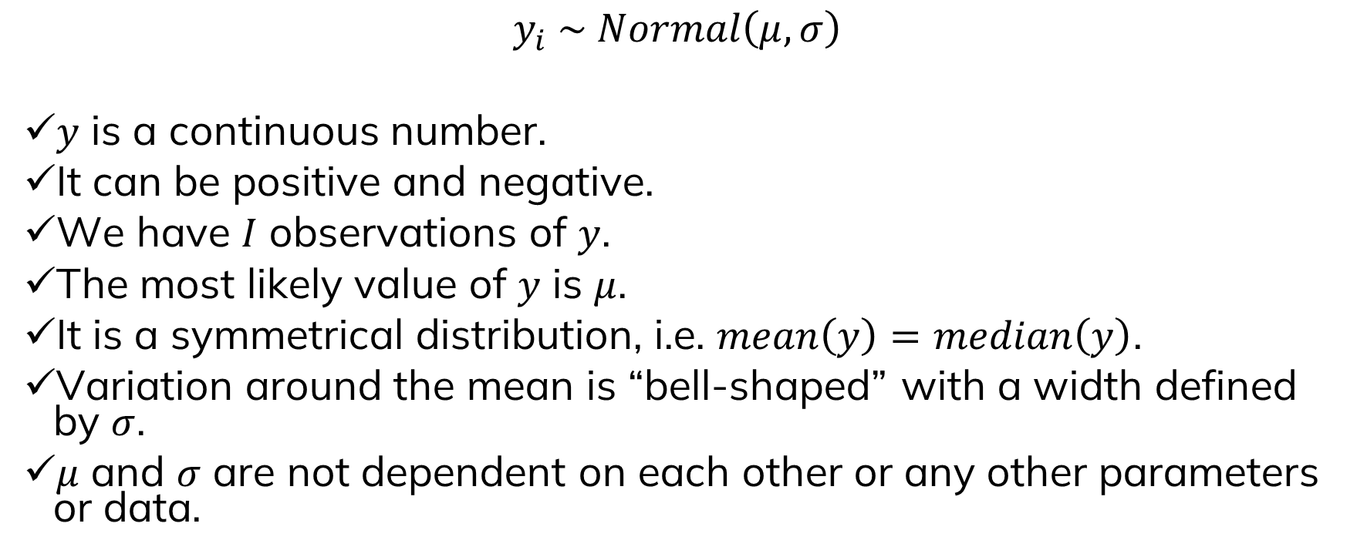
What does this likelihood tell us about our data and our hypothesis?
$$y_{i} \sim Normal\left(μ, σ\right)$$
$y$ is a continuous number.
It can be positive and negative.
We have $I$ observations of $y$.
The most likely value of $y$ is $μ$.
It is a symmetrical distribution, i.e. $mean\left(y\right)=median\left(y\right)$.
Variation around the mean is “bell-shaped” with a width defined by $σ$.
$μ$ and $σ$ are not dependent on each other or any other parameters or data.

Slide 19
Probability distributions
When designing likelihoods for data (i.e. dependent variable), we need to:
Choose an appropriate probability distribution for the data characteristics
Design a model for its parameters that reflects our hypothesis about the process that generated the data

Slide 20
Next up…. Probability distributions

Slide 21


Slide 22
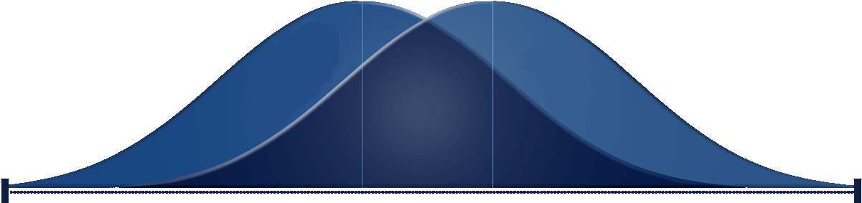
A quick tour of common probability distributions…

Slide 23
Key considerations
Continuous versus discrete
Range of support
Interpretability of parameters

Slide 24
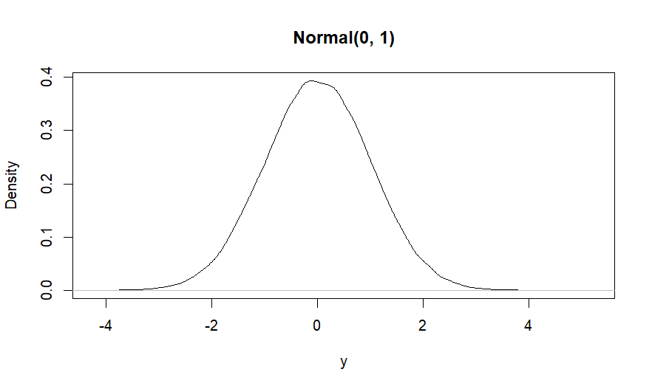
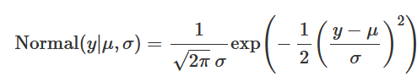
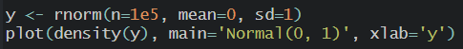
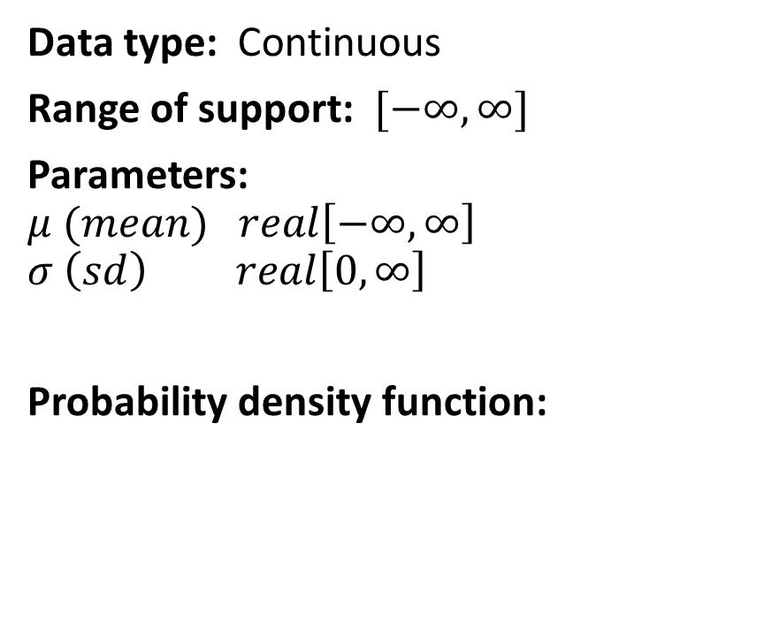
Normal distribution
Data type: Continuous
Range of support: $[−∞, ∞]$
Parameters: $$μ (mean) real\left[−∞, ∞\right] \\ σ \left(sd\right) real\left[0, ∞\right]$$
Probability density function:

Slide 25
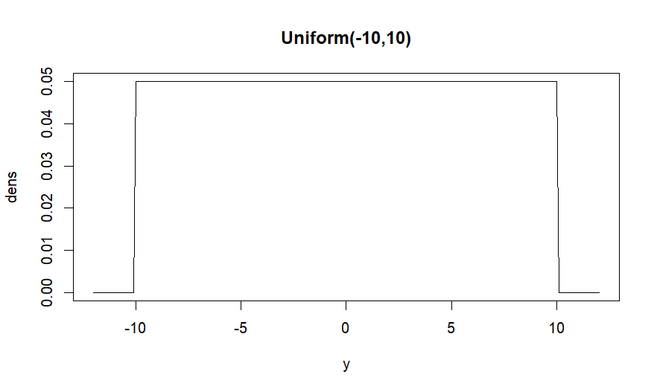
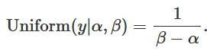
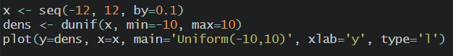
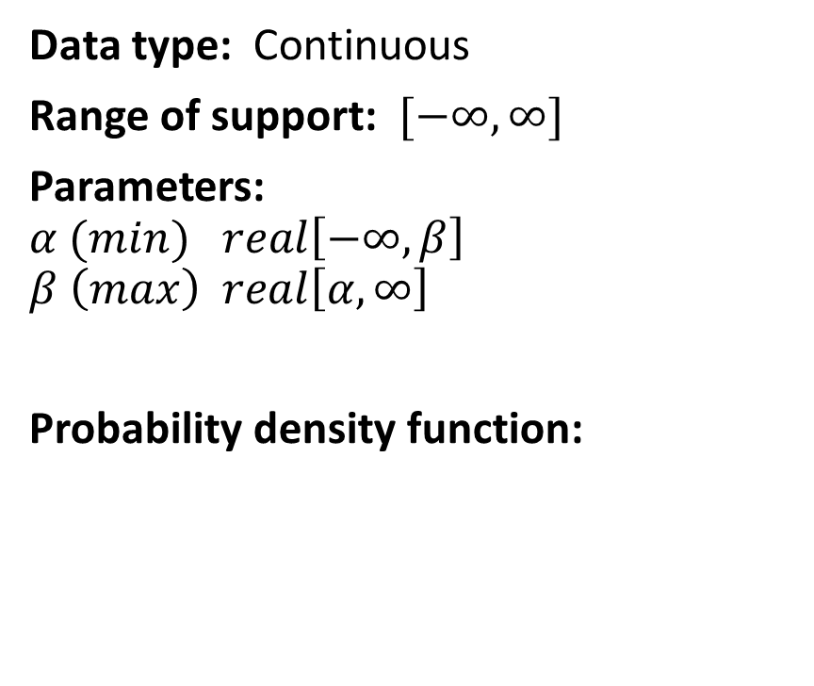
Uniform distribution
Data type: Continuous
Range of support: $[−∞, ∞]$
Parameters: $$α (min) real\left[−∞, β\right] \\ β \left(max\right) real\left[α, ∞\right]$$
Probability density function:

Slide 26
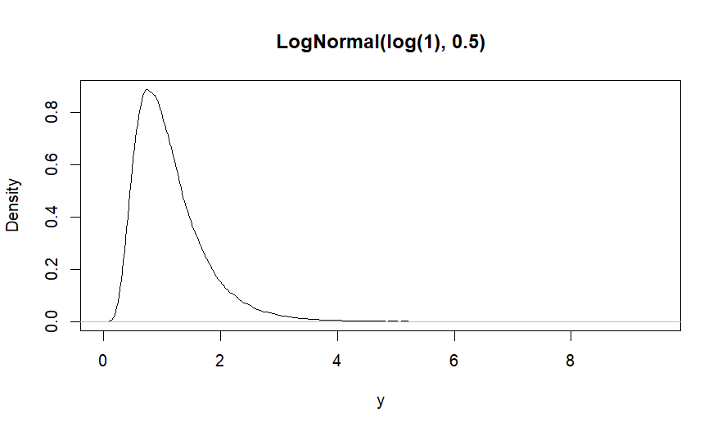
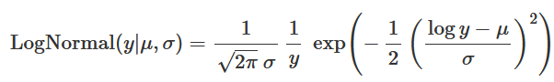
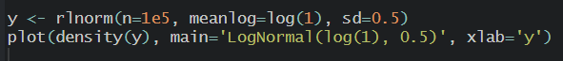
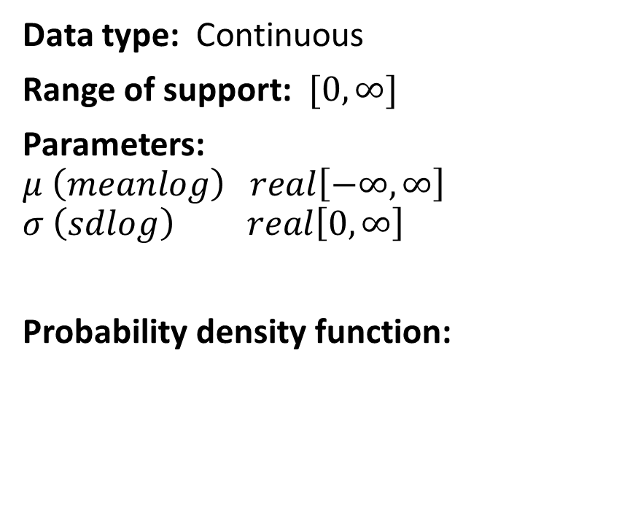
LogNormal distribution
Data type: Continuous
Range of support: $[0, ∞]$
Parameters: $$μ \left(meanlog\right) real\left[−∞, ∞\right] \\ σ \left(sdlog\right) real\left[0, ∞\right]$$
Probability density function:

Slide 27
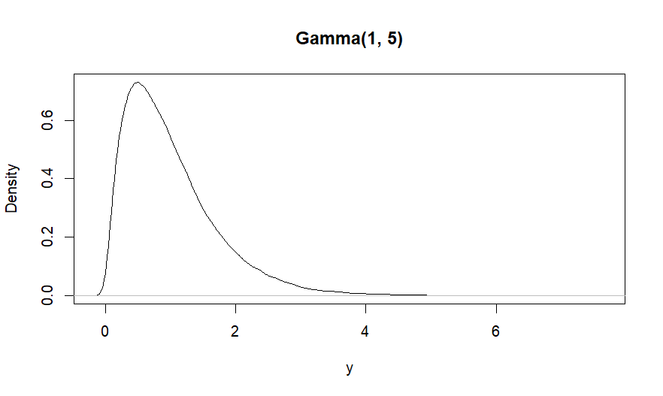
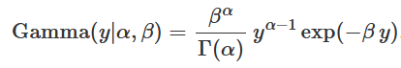
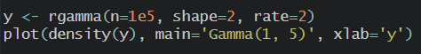
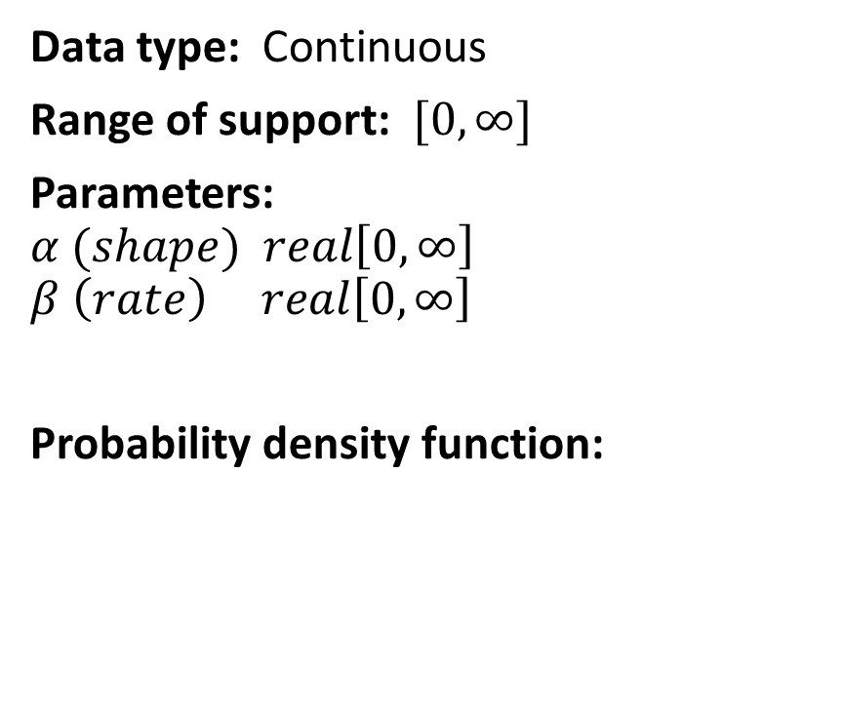
Gamma distribution
Data type: Continuous
Range of support: $[0, ∞]$
Parameters: $$α (shape) real\left[0, ∞\right] \\ β \left(rate\right) real\left[0, ∞\right]$$
Probability density function:

Slide 28
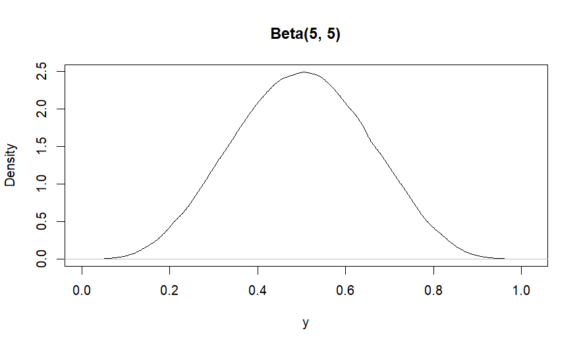
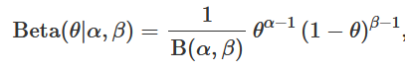
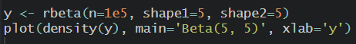
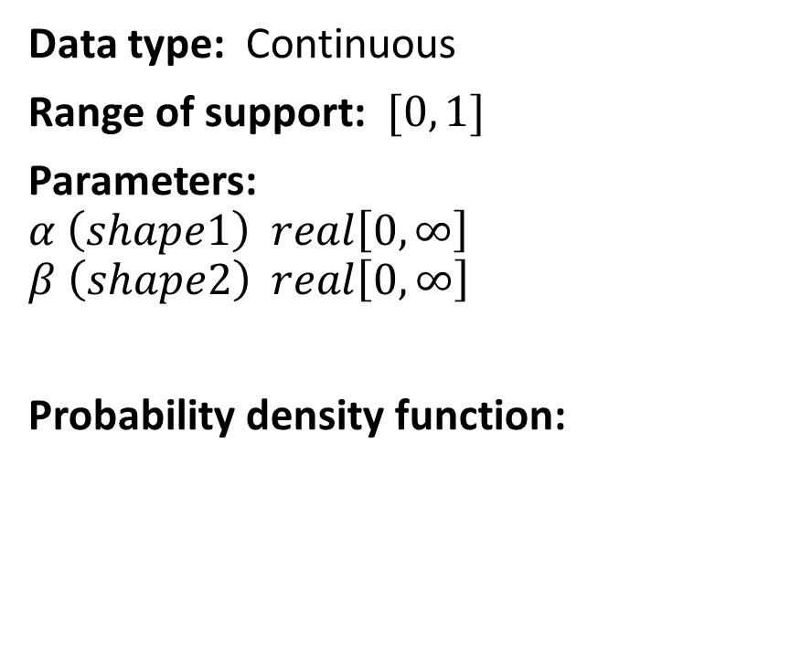
Beta distribution
Data type: Continuous
Range of support: $[0, 1]$
Parameters: $$α \left(shape1\right) real\left[0, ∞\right] \\ β \left(shape2\right) real\left[0, ∞\right]$$
Probability density function:

Slide 29
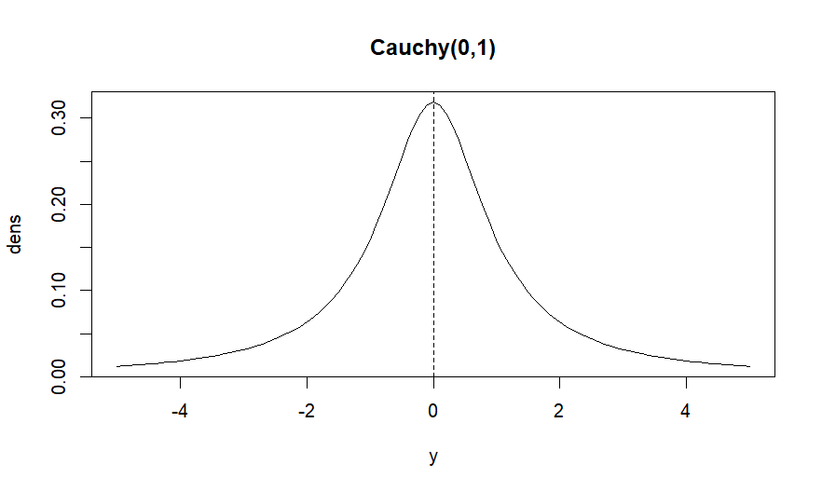
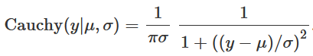
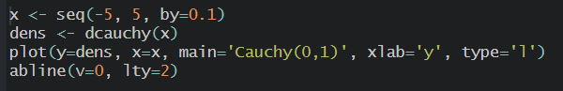
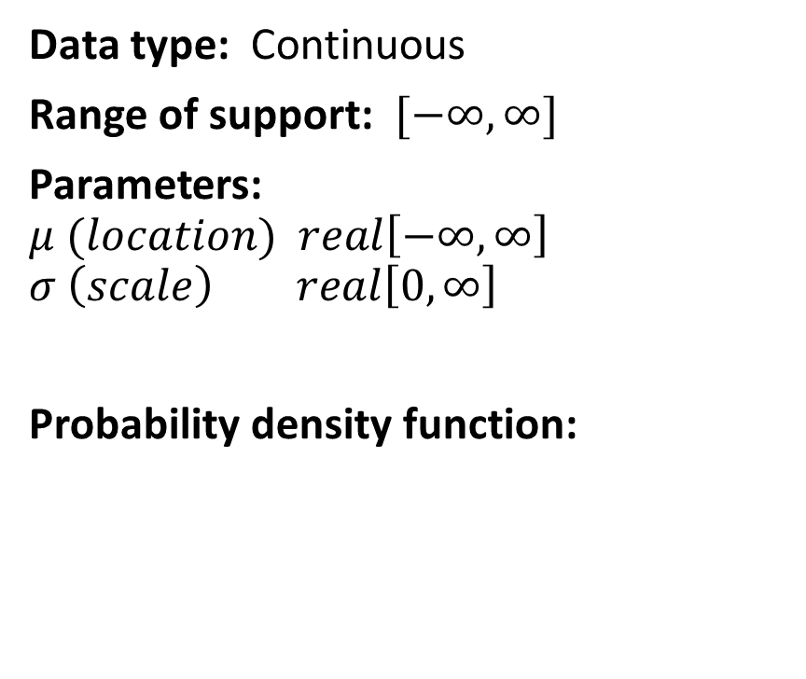
Cauchy distribution
Data type: Continuous
Range of support: $[−∞, ∞]$
Parameters: $$μ (location) real\left[−∞, ∞\right] \\ σ \left(scale\right) real\left[0, ∞\right]$$
Probability density function:

Slide 30
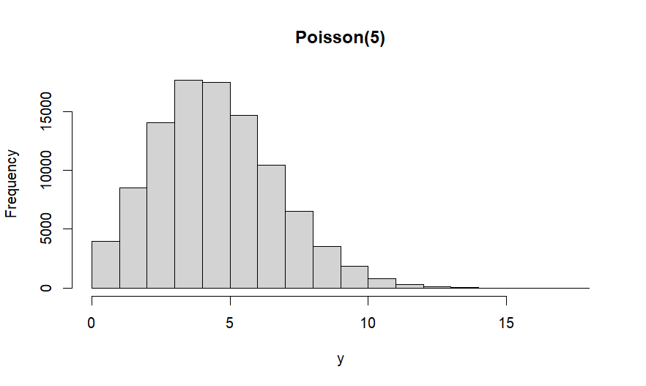



Poisson distribution
Data type: Discrete
Range of support: $[0, ∞]$
Parameters: $$λ \left(lambda\right) real\left[0, ∞\right]$$
Probability density function:

Slide 31




Binomial distribution
Data type: Discrete
Range of support: $[0, N]$
Parameters: $$N (size) int\left[0, ∞\right] \\ θ \left(prob\right) real\left[0, 1\right]$$
Probability density function:

Slide 32





Bernoulli distribution
Data type: Discrete
Range of support: $[0, 1]$
Parameters: $$θ \left(prob\right) real\left[0, 1\right]$$
Probability density function:

Slide 33




Multinomial distribution
Data type: Discrete
Range of support: $[0, N]$
Parameters: $$N (size) int\left[0, ∞\right] \\ θ_{k} \left(prob\right) real\left[0, 1\right]$$
Probability density function:

Slide 34


Method of moments
Moments: Statistics that describe a probability distribution (e.g. expected value, variance, skewness)
Method of moments: Functions to calculate an estimate of the moments from the parameters of any distribution
Example:
$$y_{i} \sim Gamma\left(α, β\right)$$
$$μ=\frac{α}{β}$$
$$σ^{2}=\frac{α}{β^{2}}$$
$$α=\frac{μ^{2}}{σ^{2}}$$
$$β=\frac{μ}{σ^{2}}$$

Slide 35
There are many more… (see “Distributions Cheat Sheet” in the readings)

Slide 36


Slide 37
Priors

Slide 38
Bayes’ theorem
$$P\left(μ,σ | y\right)=\frac{P\left(y | μ,σ\right) P\left(μ\right)P(σ)}{P\left(y\right)}$$
$y$ = data $μ$ = mean
$σ$ = standard deviation
Likelihood
Priors
Posterior

Slide 39
A prior probability …
contains our prior knowledge about a parameter in our model.
is a probability distribution.
is consistent with the numerical type of the parameter (continuous, discrete).
defines the “range of support” (i.e. range of possible values) for a parameter.
quantifies which parameter values are more likely than others.
can be informative, minimally informative, or uninformative (vague).

Slide 40
Probability distributions
When designing priors for parameters, we need to:
Choose an appropriate probability distribution for the parameter characteristics
Define values for its parameters that reflect our prior beliefs about the parameter

Slide 41


Let’s design some priors together for this model…
$$y_{i} \sim Normal\left(μ, σ\right)$$
$$μ \sim Normal\left(0, 1\right) \\ σ \sim Normal(0, 1)$$
Are these priors reasonable?
… or might you have a few Qs first?

Slide 42



Let’s design some priors together for this model…
$$y_{i} \sim Normal\left(μ, σ\right)$$
$y_{i}$ are temperatures measured at noon every day of 2023 in London.
$$μ \sim Normal\left(0, 50\right) \\ σ \sim HalfCauchy(0, 20)$$
These are informative priors. What effect would that have on our posterior probabilities for $μ$ and $σ?$ What are potential justifications and alternatives?

Slide 43
Bayes’ theorem
Likelihood
$$P\left(μ,σ | y\right)=\frac{ P\left(μ\right)P(σ)}{P\left(y\right)}$$
$y$ = data $μ$ = mean
$σ$ = standard deviation
Priors
Posterior

Slide 44




Bayes’ theorem
Likelihood
Priors
$$P\left(μ,σ | y\right)=\frac{ P\left(μ\right)P(σ)}{P\left(y\right)}$$
$y$ = data $μ$ = mean
$σ$ = standard deviation
Posterior
$$μ$$
$$σ$$

Slide 45
Conjugate priors
When the prior probability distribution has the same functional form as the likelihood, then the prior is “conjugate”
Results in the posterior having the same distributional form as the prior (e.g. if the conjugate prior is Beta, then the posterior will be Beta)
Facilitates an analytical solution to the posterior
More efficient numerical solution to the posterior (i.e. MCMC) using Gibbs sampling

Slide 46

Conjugate priors
$$y_{i} \sim Normal\left(μ, σ\right)$$
$$\frac{1}{σ^{2}} \sim Gamma(0.01, 0.01)$$

Slide 47

Conjugate priors
$$y_{i} \sim Poisson\left(λ\right)$$
$$λ \sim Gamma(0.01, 0.01)$$

Slide 48

Conjugate priors
$$y_{i} \sim Binomial\left(N, θ\right)$$
$$θ \sim Beta(1, 1)$$

Slide 49

Conjugate priors
$$y_{k} \sim Multinomial\left(N, θ_{k}\right)$$
$$θ_{k} \sim Dirichlet(1_{k})$$

Slide 50
Conjugate priors
Do we need to use conjugate priors?
No, not really. But, it can improve computational efficiency.

Slide 51
Next up…. Posterior distribution & Markov Chain Monte Carlo (MCMC)

Slide 52


Slide 53

Bayes’ theorem
$$P\left(θ | y\right)=\frac{P\left(y | θ\right) P\left(θ\right)}{P\left(y\right)}$$
$y$ = data $θ$ = parameter
Likelihood
Priors
Posterior

Slide 54

Bayes’ theorem
$$P\left(θ | y\right)∝P\left(y | θ\right) P\left(θ\right)$$
$y$ = data $θ$ = parameter
Posterior

Slide 55



Markov chain Monte Carlo (MCMC)
Andrei Markov
1856 - 1922
Monte Carlo Casino
Monte Carlo, Monaco
Stanislov Ulam
1909-1984

Slide 56


Markov chain Monte Carlo (MCMC) Metropolis-Hastings Algorithm
Nicholas Metropolis
1915-1999
Wilfred K. Hastings
1930 - 2016

Slide 57
What is our goal with MCMC?
The posterior distribution is unknown, but the likelihood and priors are known.
We want to accumulate many random samples proportionate to their density in the posterior distribution
MCMC generates these samples using the likelihood and the priors
We can then use these samples to calculate statistics describing the distribution: mean, median, variance, credible intervals, etc.
We can plot the posterior distribution using the MCMC samples the same way we plot the histogram using sample data.
Slide stolen from Mevin Hooten because I couldn’t make one better.

Slide 58

How MCMC works
MCMC produces a vector of parameter values $θ_{k}$ sampled from the posterior distribution for $K$ iterations of MCMC
$θ_{k}$ = value of parameter at iteration $k$
$θ′$ = value of parameter proposed at next iteration $k+1$ in the chain
We have a probability rule that allows us to compare the proposed value $θ^{′}$ with the current value $θ_{k}$. If $θ′$ is more probable than $θ_{k}$, then it becomes $θ_{k+1}$. Otherwise, we keep $θ_{k}=θ_{k+1}$. The frequency of values of $θ$ are proportional to the posterior density.
Slide stolen from Mevin Hooten because I couldn’t make one better.

Slide 59

How MCMC works
As the chain gets longer, the more probable values are retained more frequently than the less probable ones. This is what gives the proper shape to the simulated distribution—the frequency of values is proportionate to the probability density of the posterior distribution.
Slide stolen from Mevin Hooten because I couldn’t make one better.

Slide 60

Slide stolen from Mevin Hooten because I couldn’t make one better.

Slide 61

Slide stolen from Mevin Hooten because I couldn’t make one better.

Slide 62

Slide stolen from Mevin Hooten because I couldn’t make one better.

Slide 63

Slide stolen from Mevin Hooten because I couldn’t make one better.

Slide 64

Slide stolen from Mevin Hooten because I couldn’t make one better.

Slide 65

Are you ready to do this on your own?
Slide stolen from Mevin Hooten because I couldn’t make one better.

Slide 66

Stan does everything we just talked about for you…

Slide 67
The basics
Multiple MCMC chains
Initial values for each parameter in each chain
Burn-in period (a.k.a. warmup period) to be discarded
Samples to keep for analysis
Convergence of chains

Slide 68

A quick look…

Slide 69

A quick look…

Slide 70


A quick look…

Slide 71


A quick look…
mu
sigma

Slide 72


Convergence problems Burn-in/warmup too short

Slide 73

Convergence problems Not enough samples (although getting close)

Slide 74

Convergence problems Autocorrelation

Slide 75

Convergence problems Non-identifiability

Slide 76
Quantitative diagnostics
Rhat
Divergences
EBMI

Slide 77


Software Program Bayesian models and run MCMC samplers
JAGS Just Another Gibbs Sampler

Slide 78
Next up…. Designing your own model

Slide 79


Slide 80


Model design as a learning process
Formalise your mental picture (hypothesis) of the process that you are studying
Think about each distribution, parameter, and functional relationship
Design assumptions appropriate for the process and data.
Confront your model with data…
Learn, repeat.

Slide 81

Components of a model
$$y_{i} \sim Normal\left(μ_{i}, σ\right)$$
$$μ_{i}=α+βx_{i}$$
$$α \sim Normal\left(0, 1\right) \\ β \sim Normal\left(0, 1\right) \\ σ \sim HalfCauchy(0, 1)$$
Data model(s)
Process model(s)
Parameter model(s)

Slide 82

Process models Deterministic functions

Slide 83
Process models Deterministic functions

Slide 84


Directed Acyclic Graphs (DAGs)
Graphical depiction of relationships between every node of your model
Nodes = data or parameters
Arrows point towards the node which is dependent on the other
Arrow types indicate stochastic or deterministic relationships
$$data$$
Stochastic
Relationship
$$param$$
Deterministic
Relationship

Slide 85




Directed Acyclic Graphs (DAGs)
$$y_{i} \sim Normal(μ, σ)$$
Have we forgotten anything in this model?
Priors!
$$μ \sim Normal\left(0, 1\right) \\ σ \sim Uniform(0, 10)$$
$$y_{i}$$
$$μ$$
$$σ$$

Slide 86




Directed Acyclic Graphs (DAGs) No loops (cycles) allowed
$$y_{i}$$
$$α$$
$$β$$
$$γ$$

Slide 87







Directed Acyclic Graphs (DAGs)
$$y_{i} \sim Normal\left(μ_{i}, σ\right)$$
$$μ_{i}=α+βx_{i}$$
$$α \sim Normal\left(0, 1\right) \\ β \sim Normal\left(0, 1\right) \\ σ \sim HalfCauchy(0, 1)$$
$$x_{i}$$
$$y_{i}$$
$$μ_{i}$$
$$σ$$
$$α$$
$$β$$

Slide 88
Want to try to write a model from scratch together? If we have time…

Slide 89
Recap
Bayes theorem
Likelihood
Probability distributions
Priors
MCMC (and Posteriors)
Components of a Bayesian model
Directed Acyclic Graphs (DAGs)

Slide 90
Lab Activities
Run your first Bayesian model: Mean and variance
Explore likelihoods, priors, and posteriors
Gaussian linear regression

